Slide 1

Football players market value prediction
Data science & machine learning
ORAD DOSTRA & NIV VARDI
Github

Slide 2

Research question
Can we predict a football player market value according to various kind of stats on FIFA 22?
Data Acquisition
Data Cleaning
Data Visualization
Machine Learning
Conclusion

Slide 3
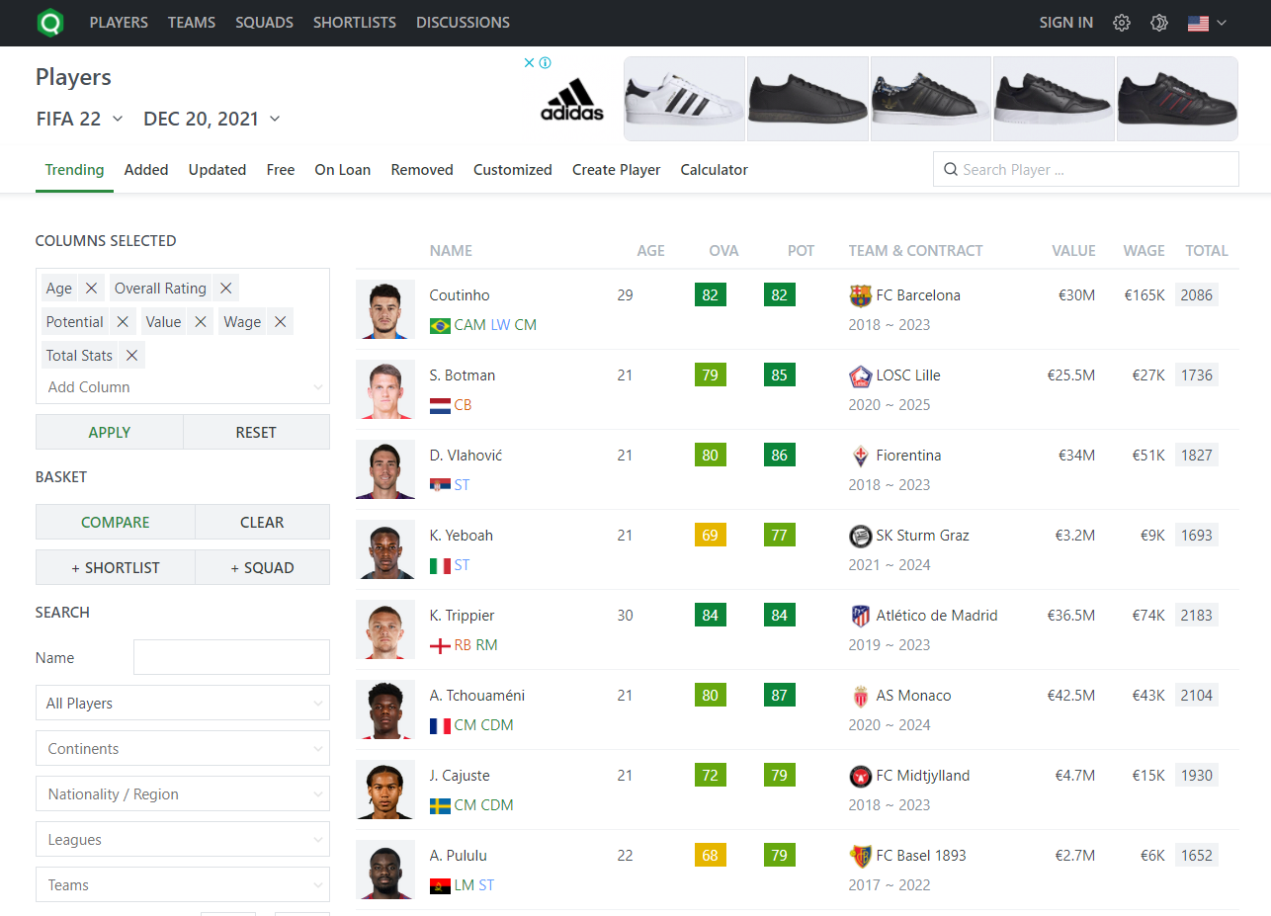
Data Acquisition
SoFifa
We created the relevant filtering for the main page of the SoFifa website using Selenium.
SoFifa
Data Acquisition
Data Cleaning
Data Visualization
Machine Learning
Conclusion

Slide 4
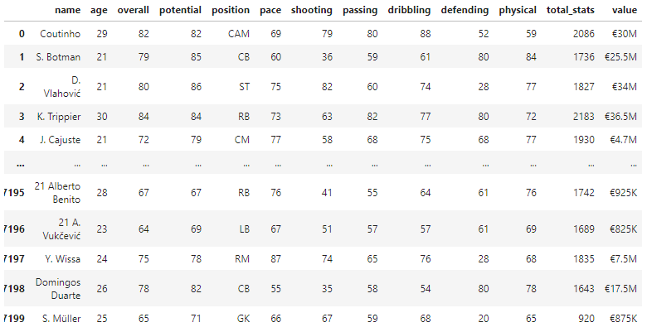
Data Acquisition
SoFifa
We scraped 100 pages of data using BeatifullSoup and stored it in a dataframe with over 7000 football players.
Data Acquisition
Data Cleaning
Data Visualization
Machine Learning
Conclusion

Slide 5

Data Cleaning
We had to clean and improve our data.
The process included:
- Deleting some rows that columns is blank
- Converting all numeric columns to integer or float.
Data Acquisition
Data Cleaning
Data Visualization
Machine Learning
Conclusion

Slide 6
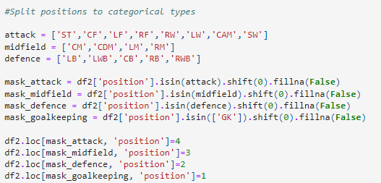
Data Cleaning
- Converting Value to decimal money. (Including €, M and K characters)
-Splitting players positions to categorical types (1-GK, 2-DEF, 3-MID, 4-ATT).
Data Acquisition
Data Cleaning
Data Visualization
Machine Learning
Conclusion

Slide 7
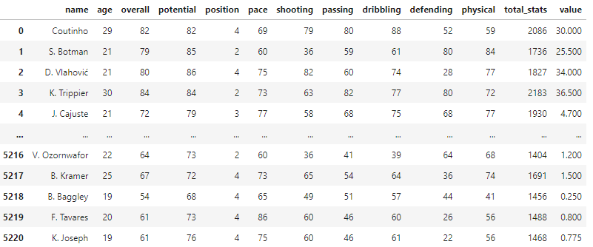
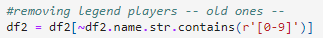
Data Cleaning
We had to deal with some outliers such as legend players that already retired from active game.
Data Acquisition
Data Cleaning
Data Visualization
Machine Learning
Conclusion

Slide 8
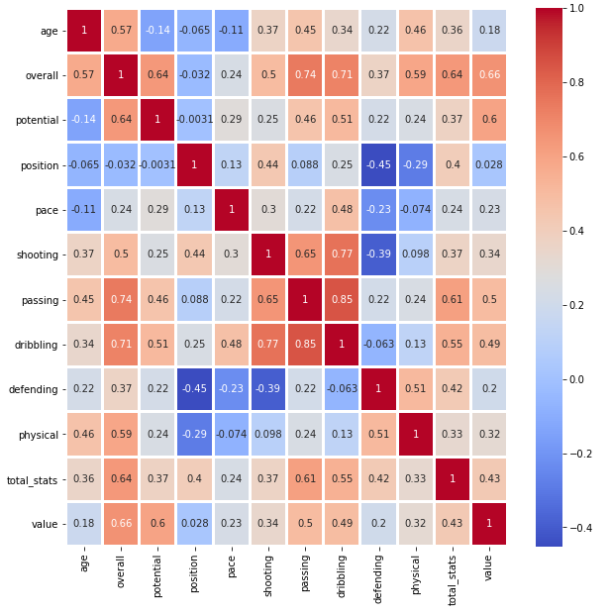
Data Visualization
Plotting the heatmap of features and target (Value) reveals some interesting trends: overall, potential, passing, dribbling and total stats seems to be very correlated with the target variable.
Data Acquisition
Data Cleaning
Data Visualization
Machine Learning
Conclusion

Slide 9
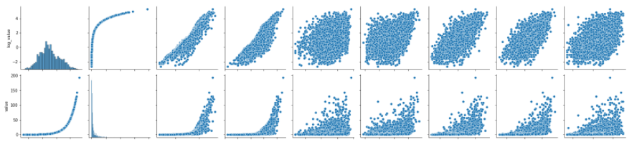
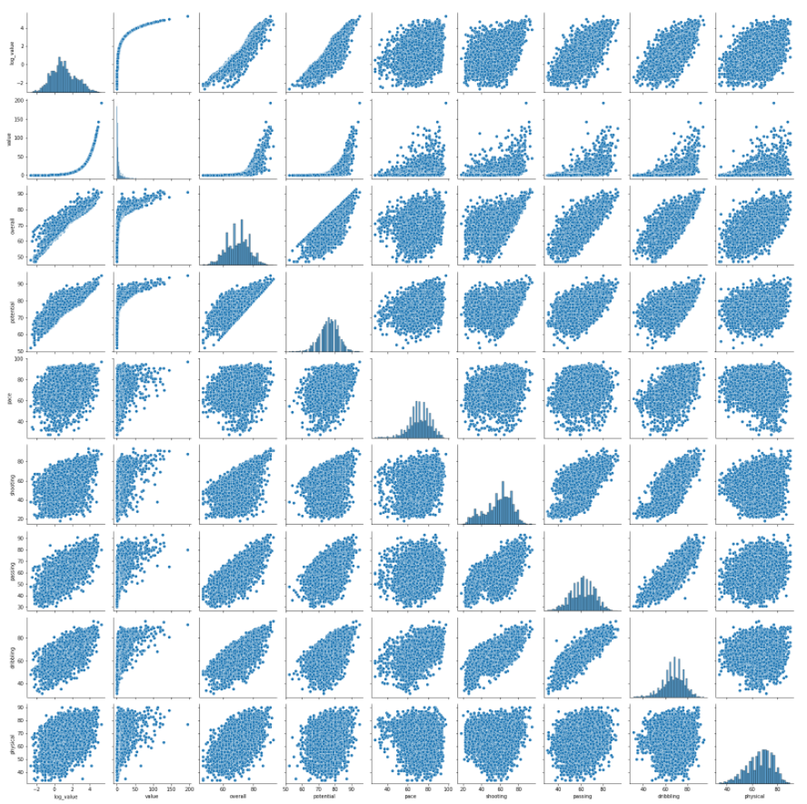
Value vs. Log Value
Log Value
Value
The pair plot also shows that the distribution of the market value is exponential. Hence, we proceed to take logarithm of the Market Value in an attempt to linearize the data.
Data Acquisition
Data Cleaning
Data Visualization
Machine Learning
Conclusion

Slide 10
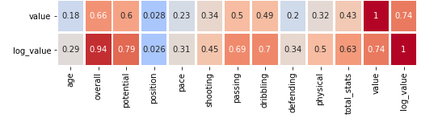
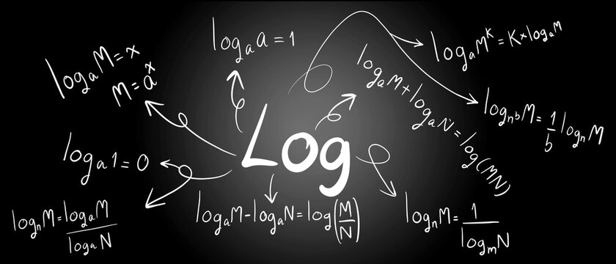
Value vs. Log Value
From a quick look on the new heatmap you can easily conclude that the correlation with the target variable improved hugely across the features.
Data Acquisition
Data Cleaning
Data Visualization
Machine Learning
Conclusion

Slide 11

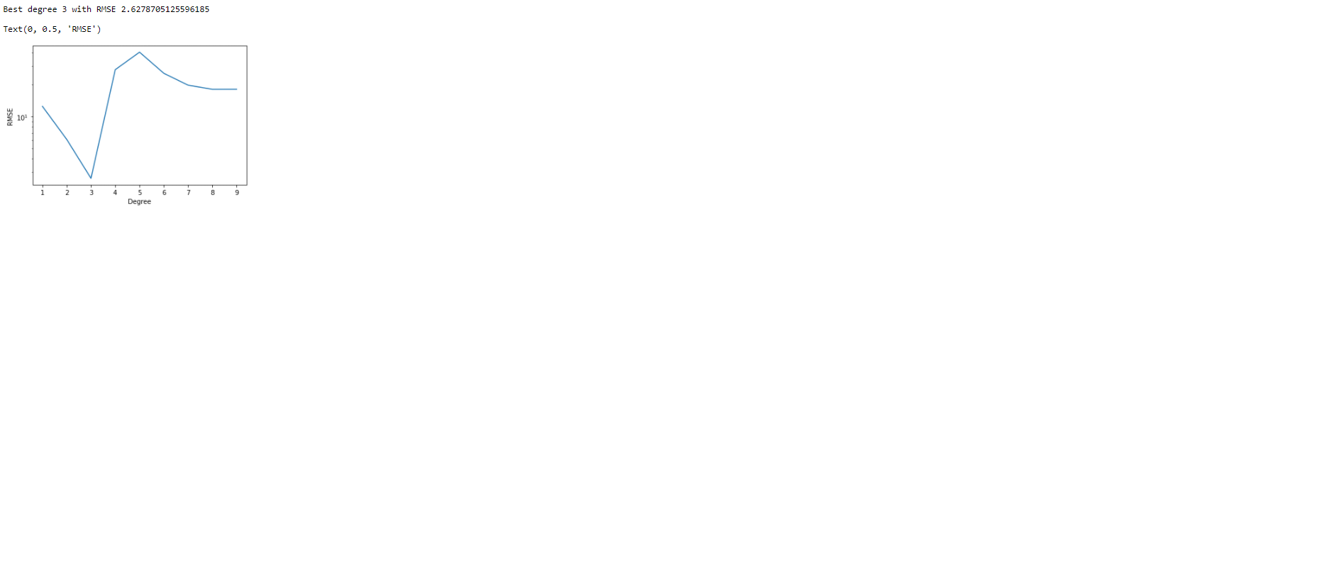
Machine Learning
Now, to fit the data, the regression models that we wish to compare are Simple Linear Regression and Polynomial Regression.
For Polynomial Regression we had to find out which degree is the optimal and we got that 3 is the optimal degree.
Data Acquisition
Data Cleaning
Data Visualization
Machine Learning
Conclusion

Slide 12


Machine Learning
Before proceeding, we randomly split the entire data frame into 80% Training Set and 20% Test set, where we hold out the Test Set for final model evaluation.
Data Acquisition
Data Cleaning
Data Visualization
Machine Learning
Conclusion

Slide 13
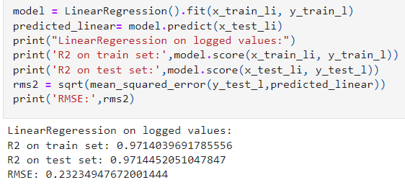

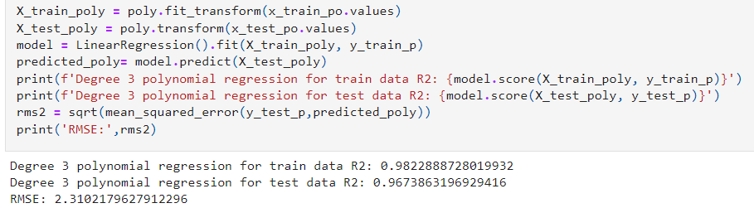
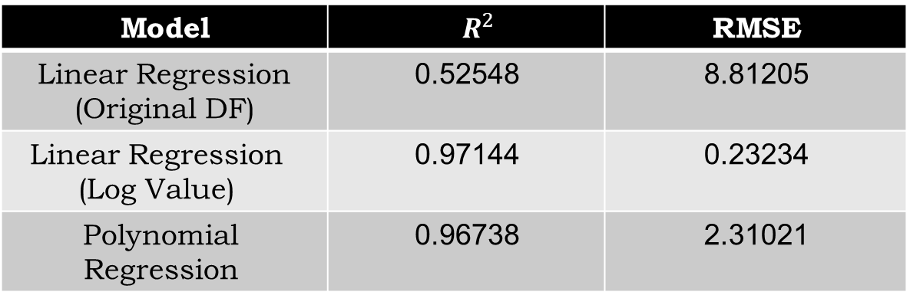
Machine Learning
By taking mean scores (Mean Squared Error) on the test set and comparing the performance of the models, it is clear that Linear Regression (Log Value) is the winner.
RMSE | $$R^{2}$$ | Model
8.81205 | 0.52548 | Linear Regression (Original DF)
0.23234 | 0.97144 | Linear Regression (Log Value)
2.31021 | 0.96738 | Polynomial Regression
Data Acquisition
Data Cleaning
Data Visualization
Machine Learning
Conclusion

Slide 14
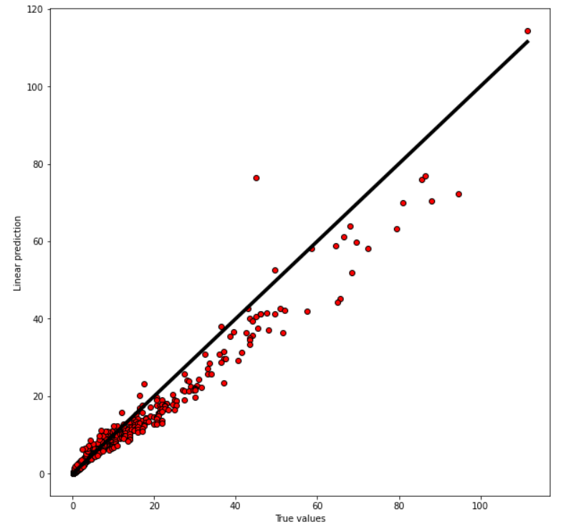
Conclusion
Regression is linear in parameters and correctly specified.
We can visually check this assumption, plotting predictions vs. actual. We should observe that the points are approximately symmetric about a line through the origin with slope.
Data Acquisition
Data Cleaning
Data Visualization
Machine Learning
Conclusion

Slide 15
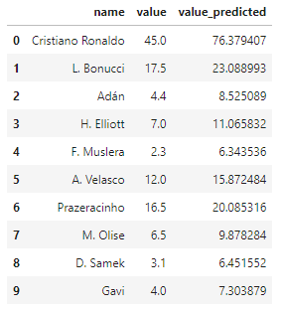
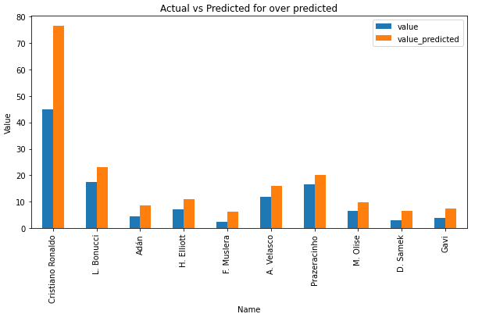
Conclusion
Let’s find which players are most over valued and which are most under valued player.
Biggest negative difference is 31.37 million € for C. Ronaldo. Actual market value of Ronaldo is 45 million € but model predicted value is 76.37 million €.
Data Acquisition
Data Cleaning
Data Visualization
Machine Learning
Conclusion

Slide 16
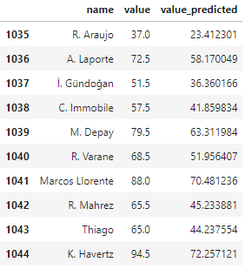
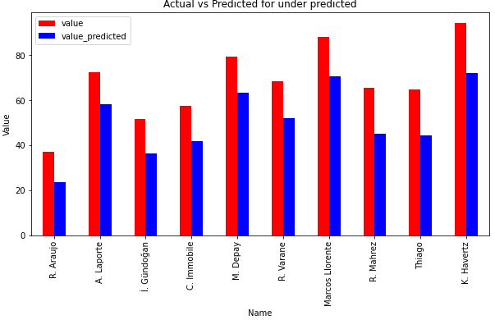
Conclusion
Biggest positive difference is 22.24 million € for K. Havertz. Actual market value of Havertz is 94.5 million € but model predicted value is 72.257 million €.
Data Acquisition
Data Cleaning
Data Visualization
Machine Learning
Conclusion

Slide 17
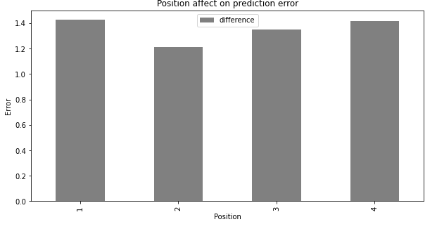
Conclusion
Finally we wanted to check if the position of a player affected on the predicted market value. We should observe that there’s no specific position that made a special influence on the prediction.
1 GK
2 DEF
3 MID
4 ATT
Data Acquisition
Data Cleaning
Data Visualization
Machine Learning
Conclusion

Slide 18
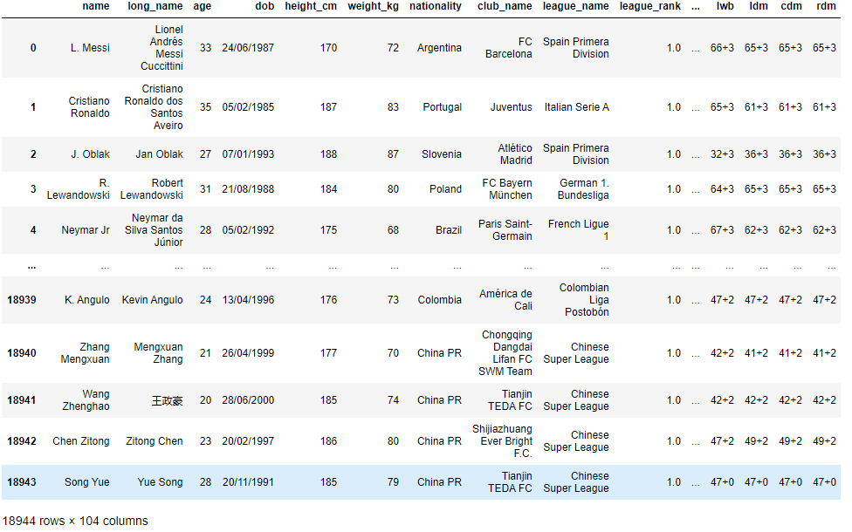
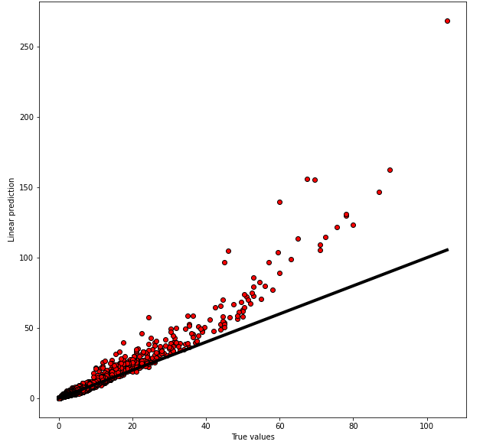
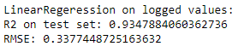
Conclusion
For conclusion we wanted to check our model accuracy on FIFA 21 dataset and still we got amazing results as you can see.
Data Acquisition
Data Cleaning
Data Visualization
Machine Learning
Conclusion

Slide 19

Thank you for reading our research and we hope you like it!
Data Acquisition
Data Cleaning
Data Visualization
Machine Learning
Conclusion

